Slide 1
Database Systems
Lecture 13
EER model, super and subclasses

Slide 2
Today’s Agenda
Enhanced Entity Relationship (EER)
Superclass, subclass and inheritance

Slide 3
Why we need EER modeling?
ER modeling concepts discussed so far are sufficient for representing many database schemas for "traditional" database applications,
Design more accurate database schemas that reflect the data properties and constraints more precisely.
Databases for engineering design and manufacturing
Telecommunications
Complex software systems
Geographic Information Systems (GIs)
More complex requirements
Led to the development of additional semantic data modeling concepts

Slide 4
Enhanced-ER (EER) Model Concepts
Includes all modeling concepts of basic ER
Additional concepts: subclasses/superclasses, specialization/generalization, categories, attribute inheritance
The resulting model is called the Enhanced-ER or Extended ER (E2R or EER) model
It is used to model applications more completely and accurately with additional semantics
It includes some object-oriented concepts, such as inheritance

Slide 5
Subclasses and Superclasses (1)
An entity type may have additional meaningful subgroupings of its entities
Example: EMPLOYEE may be further grouped into SECRETARY, ENGINEER, MANAGER, TECHNICIAN, SALARIED_EMPLOYEE, HOURLY_EMPLOYEE,…
Each of these groupings is a subset of EMPLOYEE entities
Each is called a subclass of EMPLOYEE
EMPLOYEE is the superclass for each of these subclasses
These are called superclass/subclass relationships.
Example: EMPLOYEE/SECRETARY, EMPLOYEE/TECHNICIAN

Slide 6
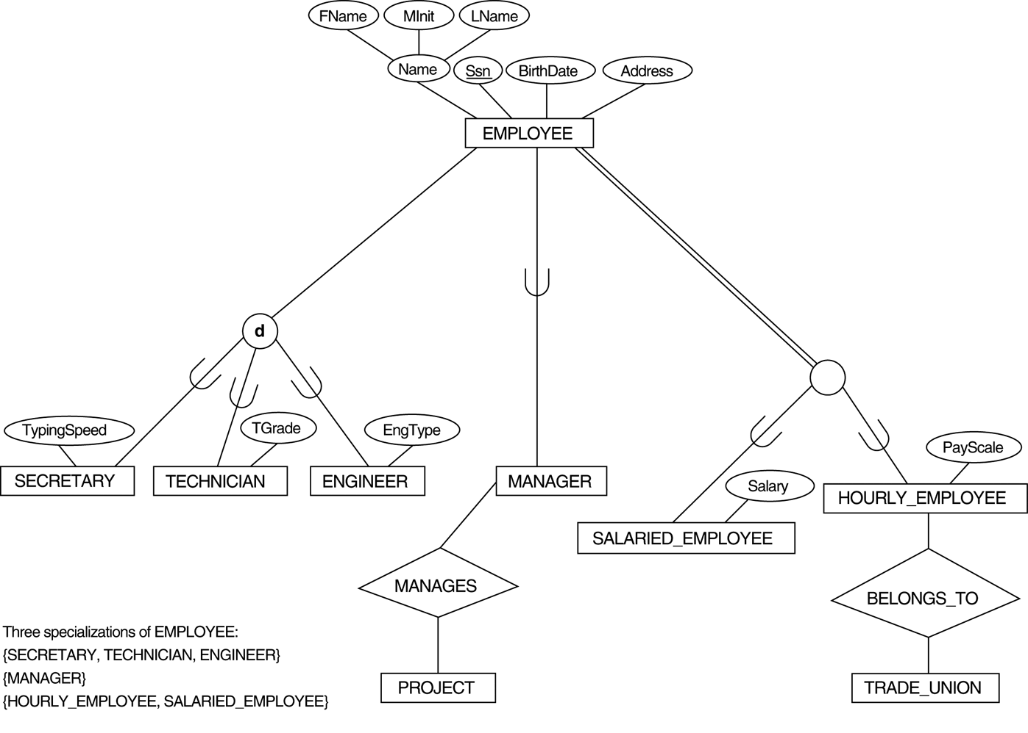
EER diagram notation to represent subclasses and specialization

Slide 7
Subclasses and Superclasses (2)
These are also called IS-A relationships (SECRETARY IS-A EMPLOYEE, TECHNICIAN IS-A EMPLOYEE, …).
Note: An entity that is member of a subclass represents the same real-world entity as some member of the superclass
The Subclass member is the same entity in a distinct specific role
An entity cannot exist in the database merely by being a member of a subclass; it must also be a member of the superclass
A member of the superclass can be optionally included as a member of any number of its subclasses
Example: A salaried employee who is also an engineer belongs to the two subclasses ENGINEER and SALARIED_EMPLOYEE
It is not necessary that every entity in a superclass be a member of some subclass

Slide 8
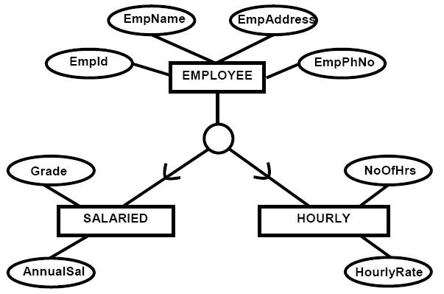
Example

Slide 9
Attribute Inheritance in Superclass / Subclass Relationships
An entity that is member of a subclass inherits all attributes of the superclass
It also inherits all relationships of the superclass

Slide 10
EER diagram notation to represent subclasses and specialization

